Slide 1

TailBench
Ansh Sarkar
Aditeya Baral
Vishesh P

Slide 2
Introduction
Latency-critical applications, common in datacenters, must achieve small and predictable tail (e.g., 95th or 99th percentile) latencies.
Their strict performance requirements limit utilization and efficiency in current datacenters.
TailBench is a benchmark suite and evaluation methodology that makes latency-critical workloads easy to run.
TailBench includes eight applications that span a wide range of latency requirements and domains, and a harness that implements a robust and statistically sound load-testing methodology.
The modular design of the TailBench harness facilitates multiple load-testing scenarios, ranging from multi-node configurations that capture network overheads, to simplified single-node configurations that allow measuring tail latency in simulation.

Slide 3
Applications in TailBench
img-dnn: Used to perform handwriting image recognition using the MNIST dataset.
masstree: Used to store data as key-value pairs
moses: Used to perform statistical machine translation
shore: On disk database to perform OLTP
silo: In memory database to perform OLTP
specjbb: Industry standard Java middleware benchmark
sphinx: Speech recognition suite
xapian: Open source search engine

Slide 4
Work Plan
The plan is to build and run each of the 8 applications and compare their tail latencies using various metrics against various simulation conditions of hardware usage such as the number of CPU cores, threads and RAM usage.
The secondary objective is to find the most optimum environment performance-wise to run each of these applications with the corresponding hardware by finding out how each of the components of cores, threads and RAM affect the application’s runtime.

Slide 5
Current Workflow - I
We have managed to build and run 4 out of the given 8 applications – img-dnn, masstree, silo and specjbb.
We created several environments on Google Cloud Platform (GCP) with different combination of cores and memory.
We also executed the applications on these instances by explicitly shutting down a few cores and obtained results on an application’s dependency on CPU and RAM usage.

Slide 6
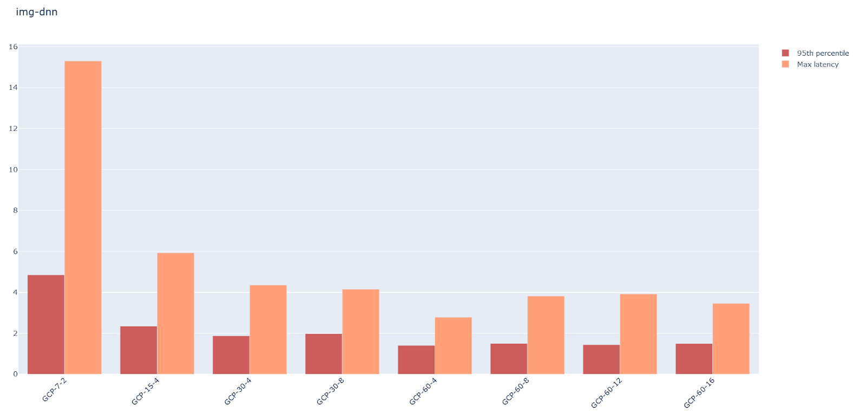
Observations – img-dnn
Plot of 95th percentile tail latencies vs system configurations
Representation: GCP-<RAM>-<CPU cores>

Slide 7
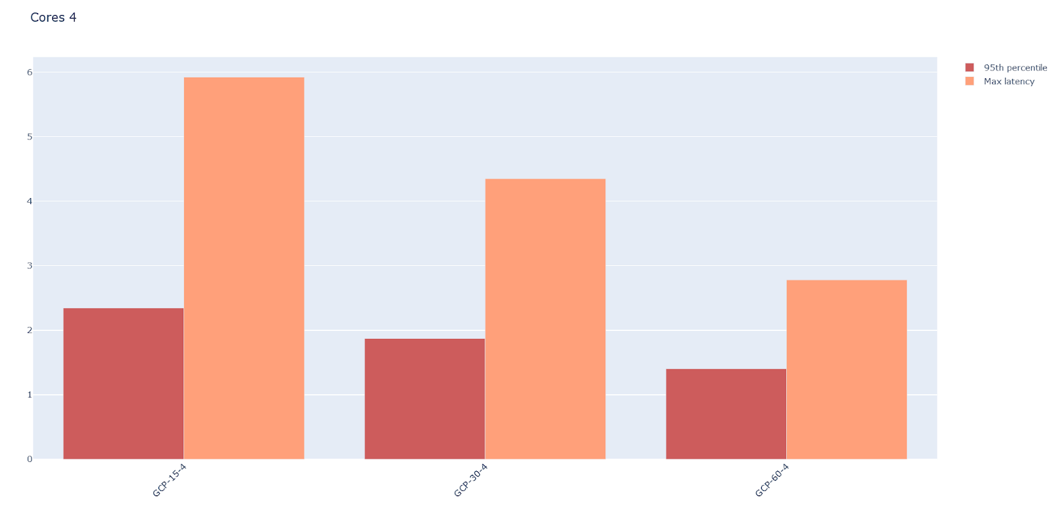
Variation with RAM with 4 cores- img-dnn

Slide 8
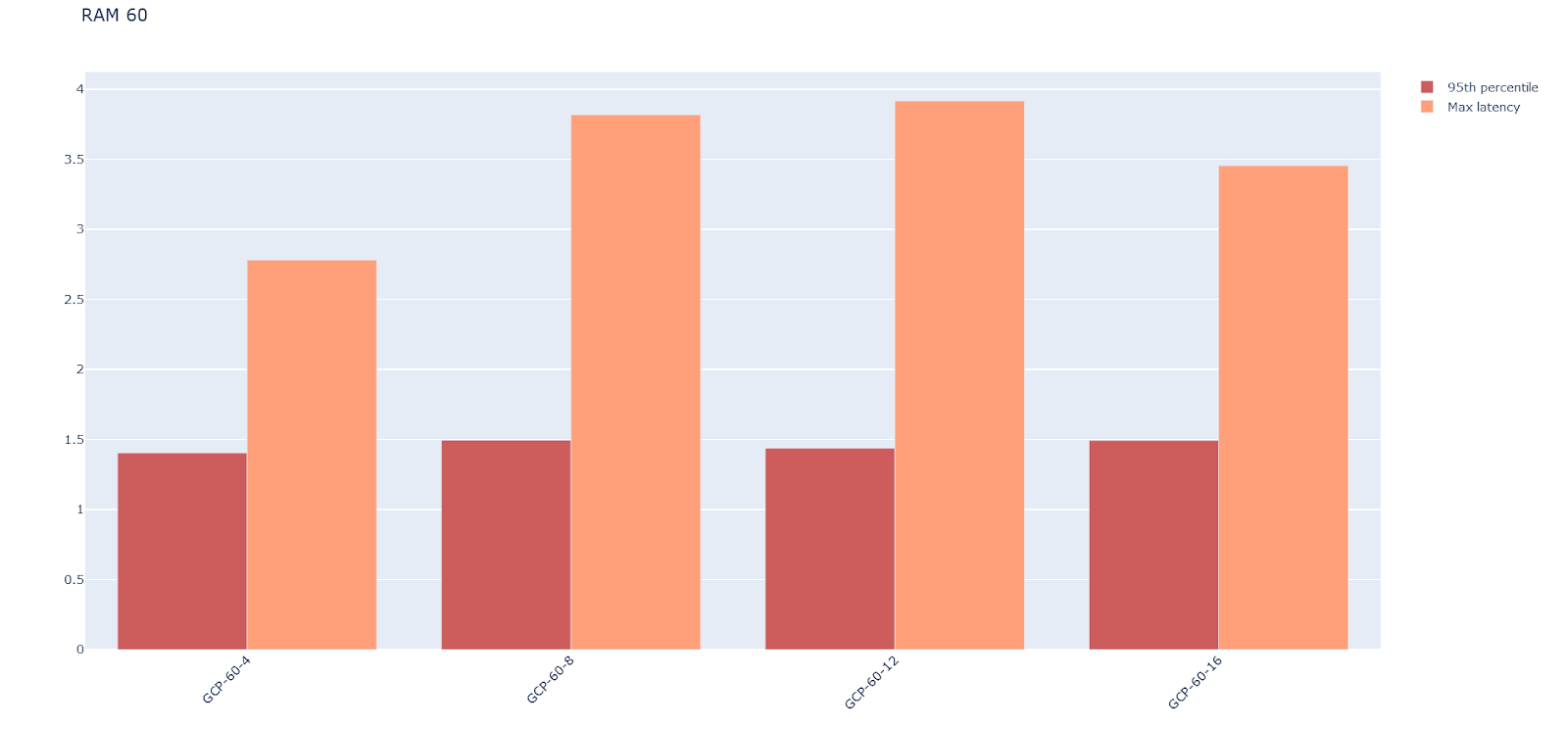
Variation with Cores with 60 GB RAM – img-dnn

Slide 9
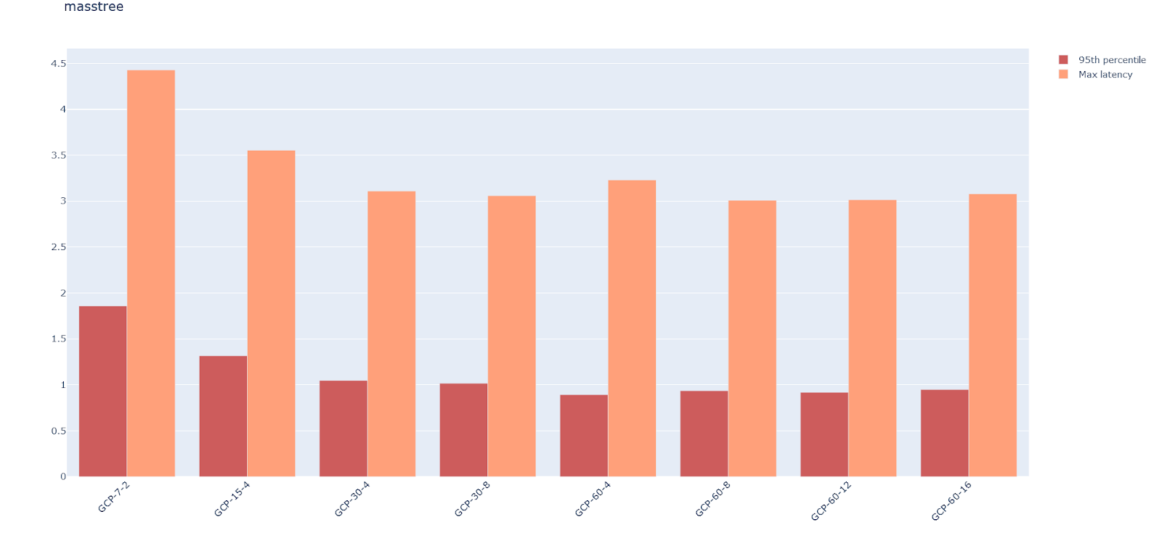
Observations – masstree
Plot of 95th percentile tail latencies vs system configurations
Representation: GCP-<RAM>-<CPU cores>

Slide 10
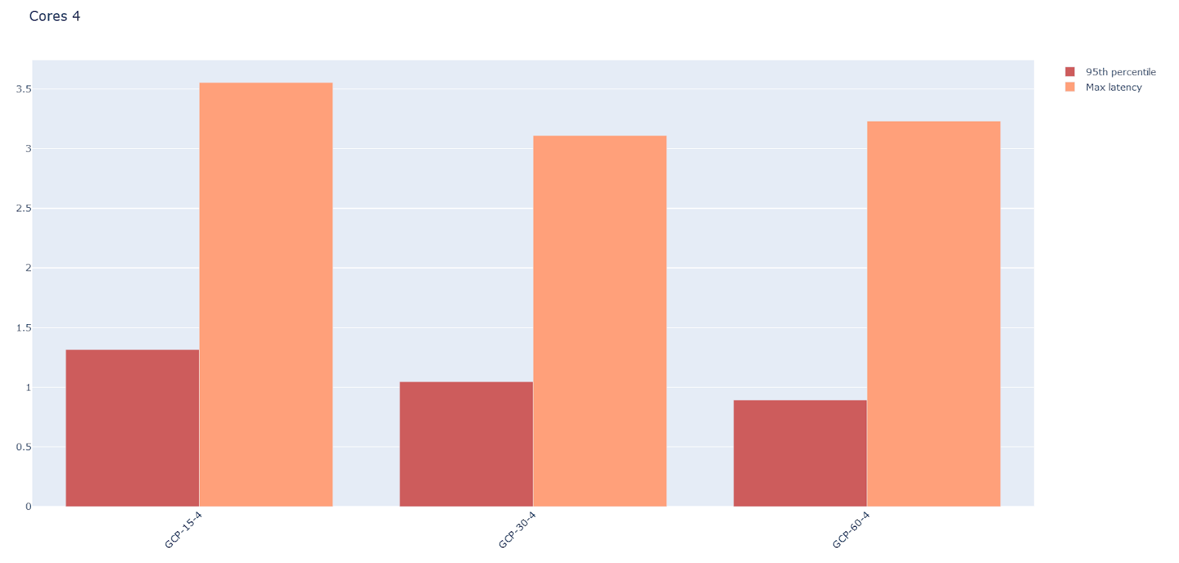
Variation with RAM with 4 cores- masstree

Slide 11
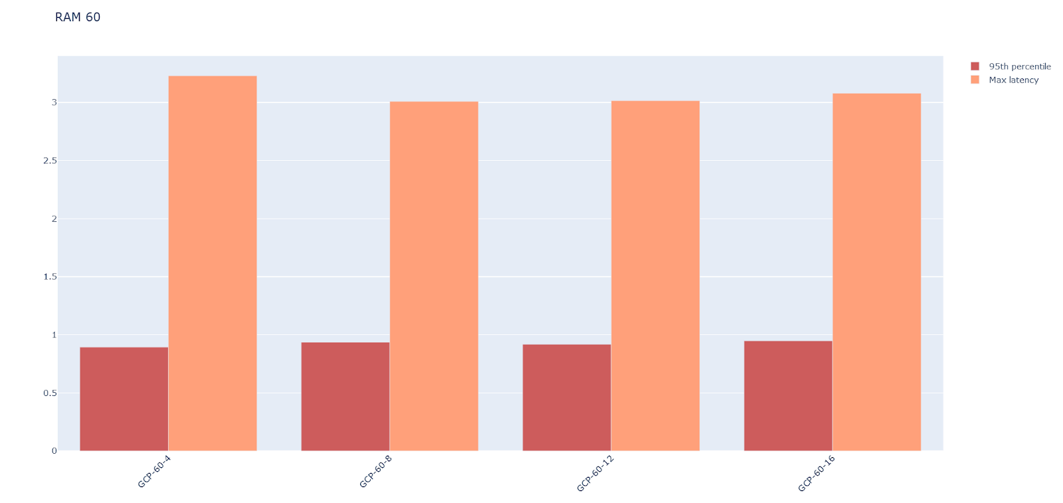
Variation with Cores with 60 GB RAM – masstree

Slide 12
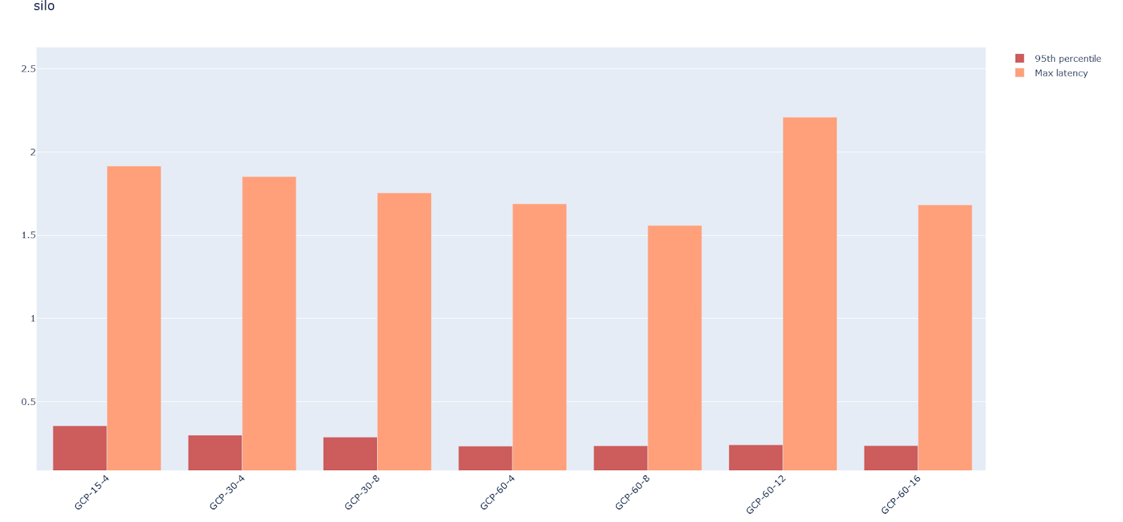
Observations – silo
Plot of 95th percentile tail latencies vs system configurations
Representation: GCP-<RAM>-<CPU cores>

Slide 13
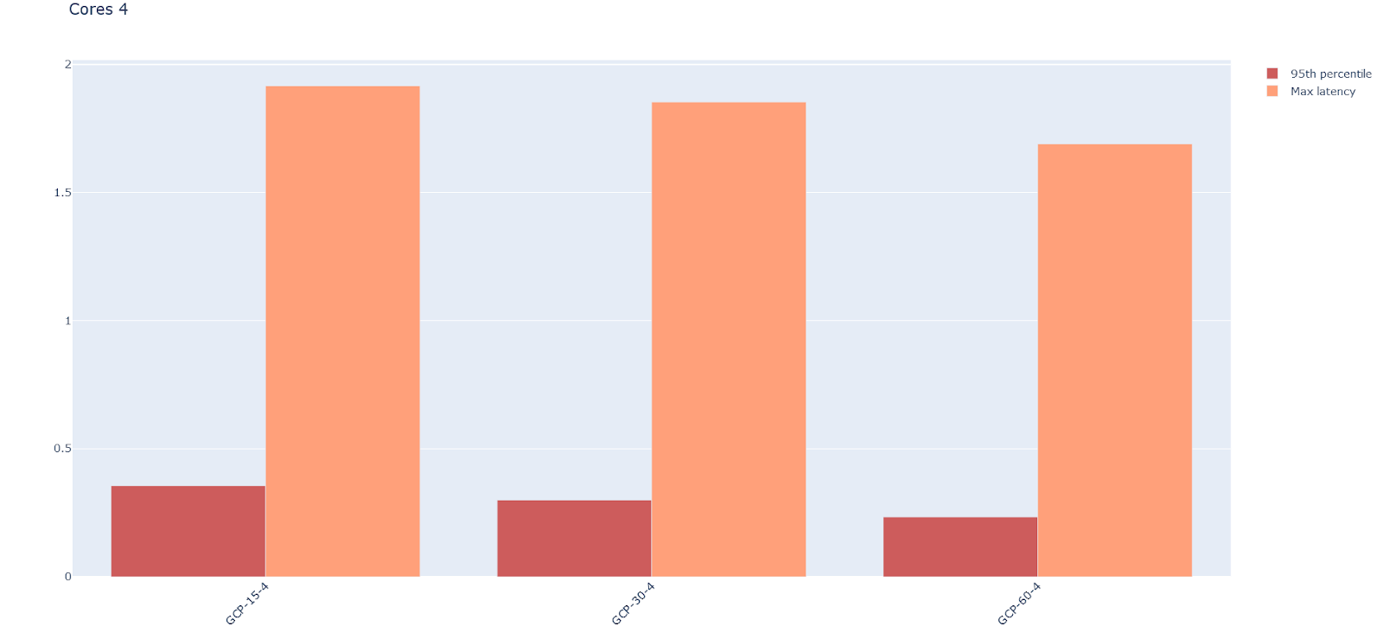
Variation with RAM with 4 cores - silo

Slide 14
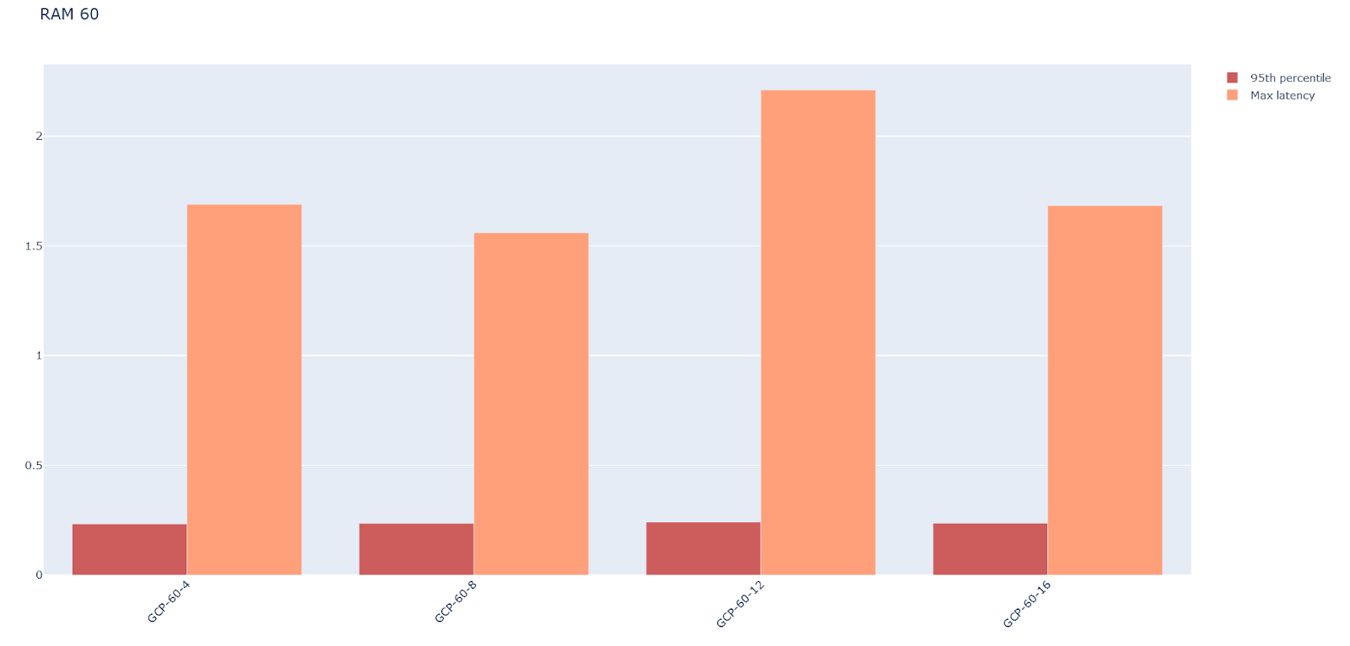
Variation with Cores with 60 GB RAM – silo

Slide 15
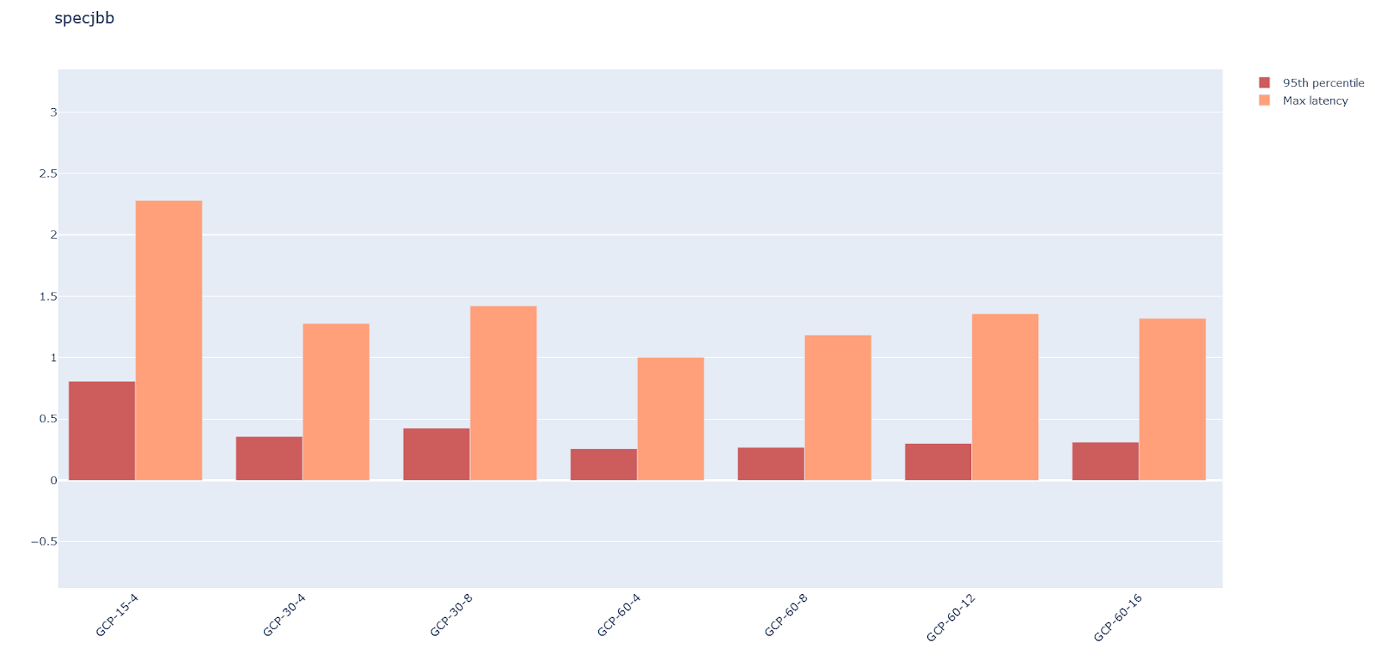
Observations – specjbb
Plot of 95th percentile tail latencies vs system configurations
Representation: GCP-<RAM>-<CPU cores>

Slide 16
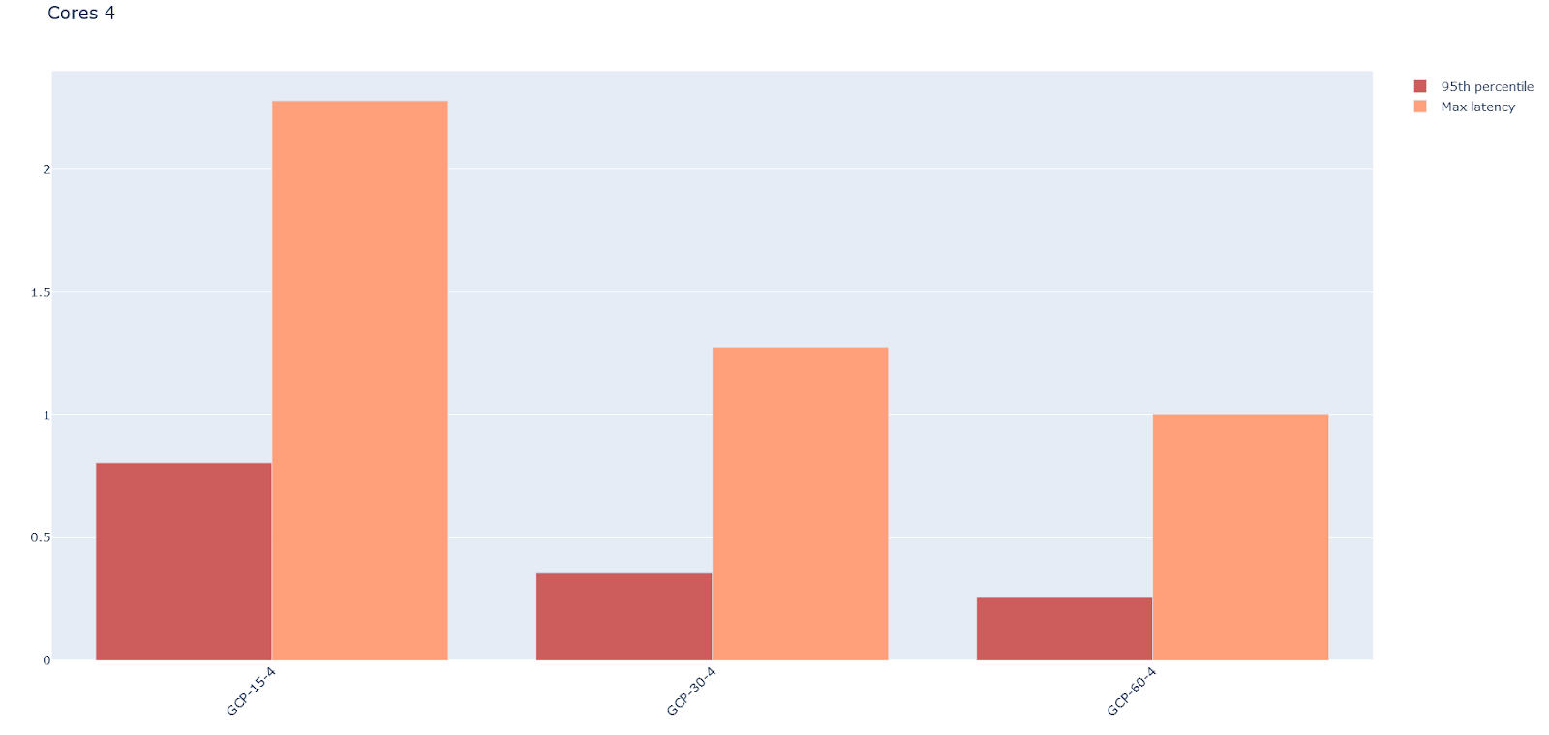
Variation with RAM with 4 cores- specjbb

Slide 17
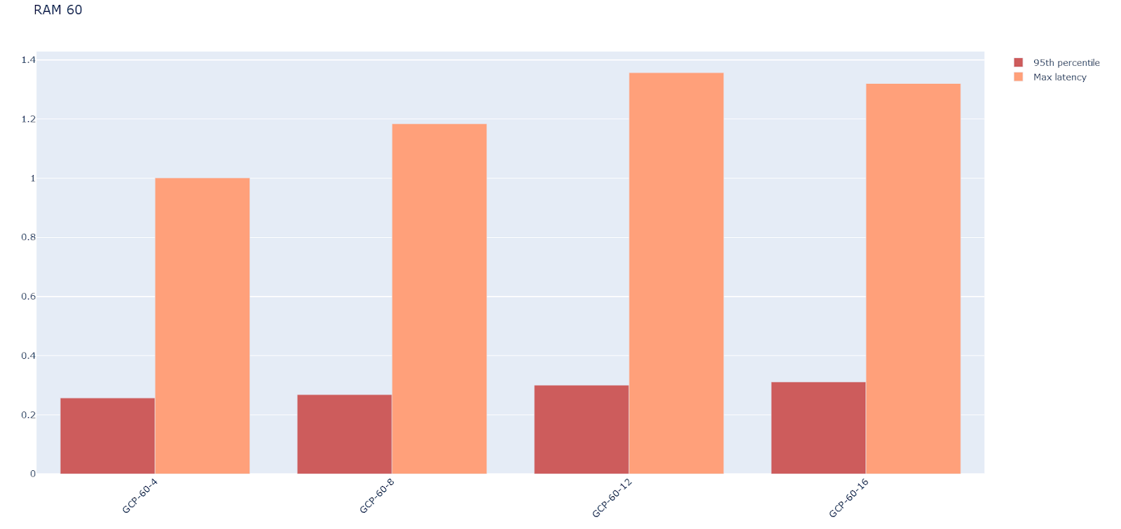
Variation with Cores with 60 GB RAM – specjbb

Slide 18
Conclusion - I
With increase in cores and memory, there is a significant decrease in tail latency at first but the curve flattens out towards at the end and the difference is negligible.
The boost in performance is primarily due to the increase in memory of the system, whereas the number of CPU cores do not seem to affect the latencies much.

Slide 19
Current Workflow - II
We are trying to build the remaining 4 applications – sphinx, xapian, moses and shore and have also tried to contact the original authors of the TailBench paper for the same.
We managed to extract the threads taken per application and were also able to analyse the CPU and memory usage of the threads during each of the 4 applications’ runtime.
We plotted the results similarly and analysed the results. Representation: <Application name>-<RAM>-<CPU Cores>.

Slide 20
img-dnn

Slide 21
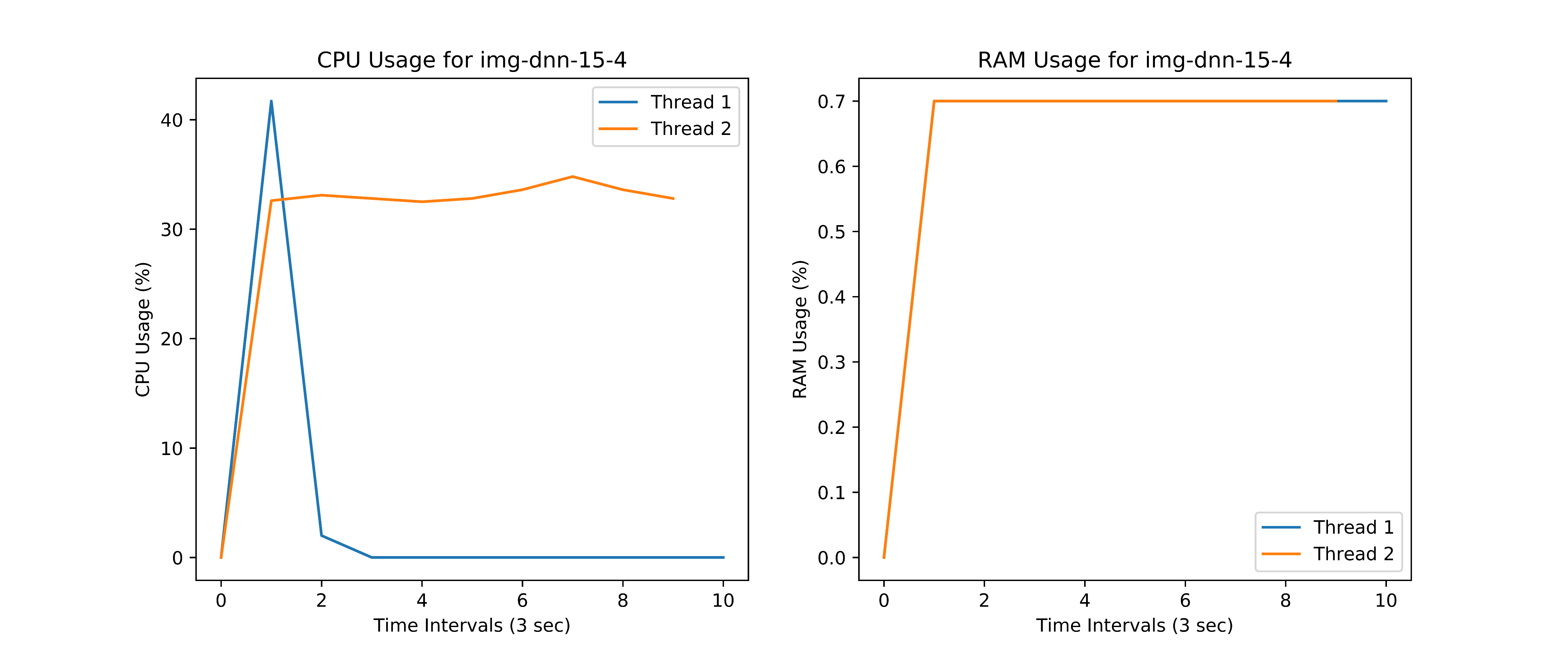
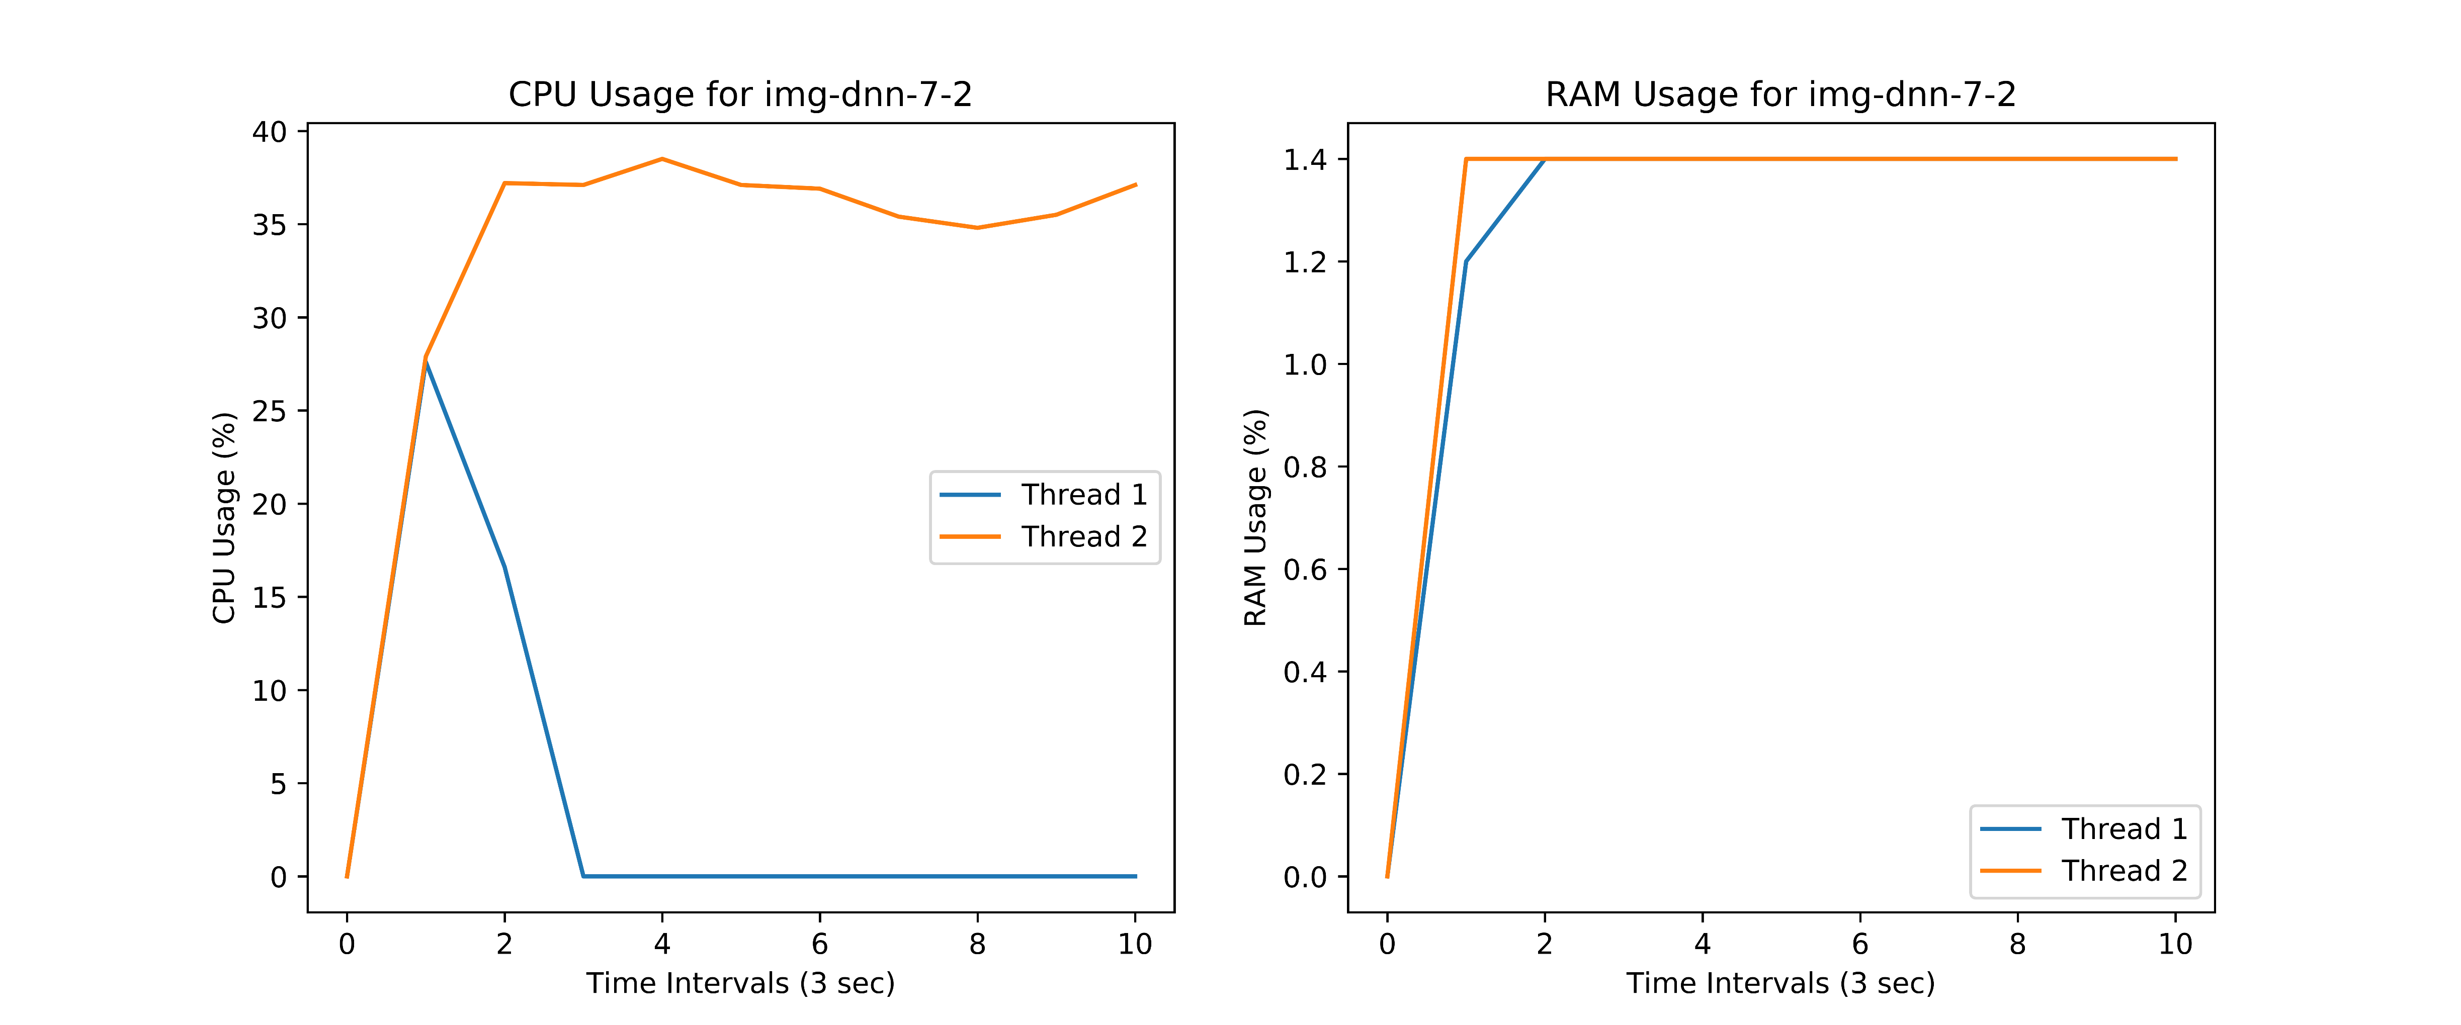

Slide 22
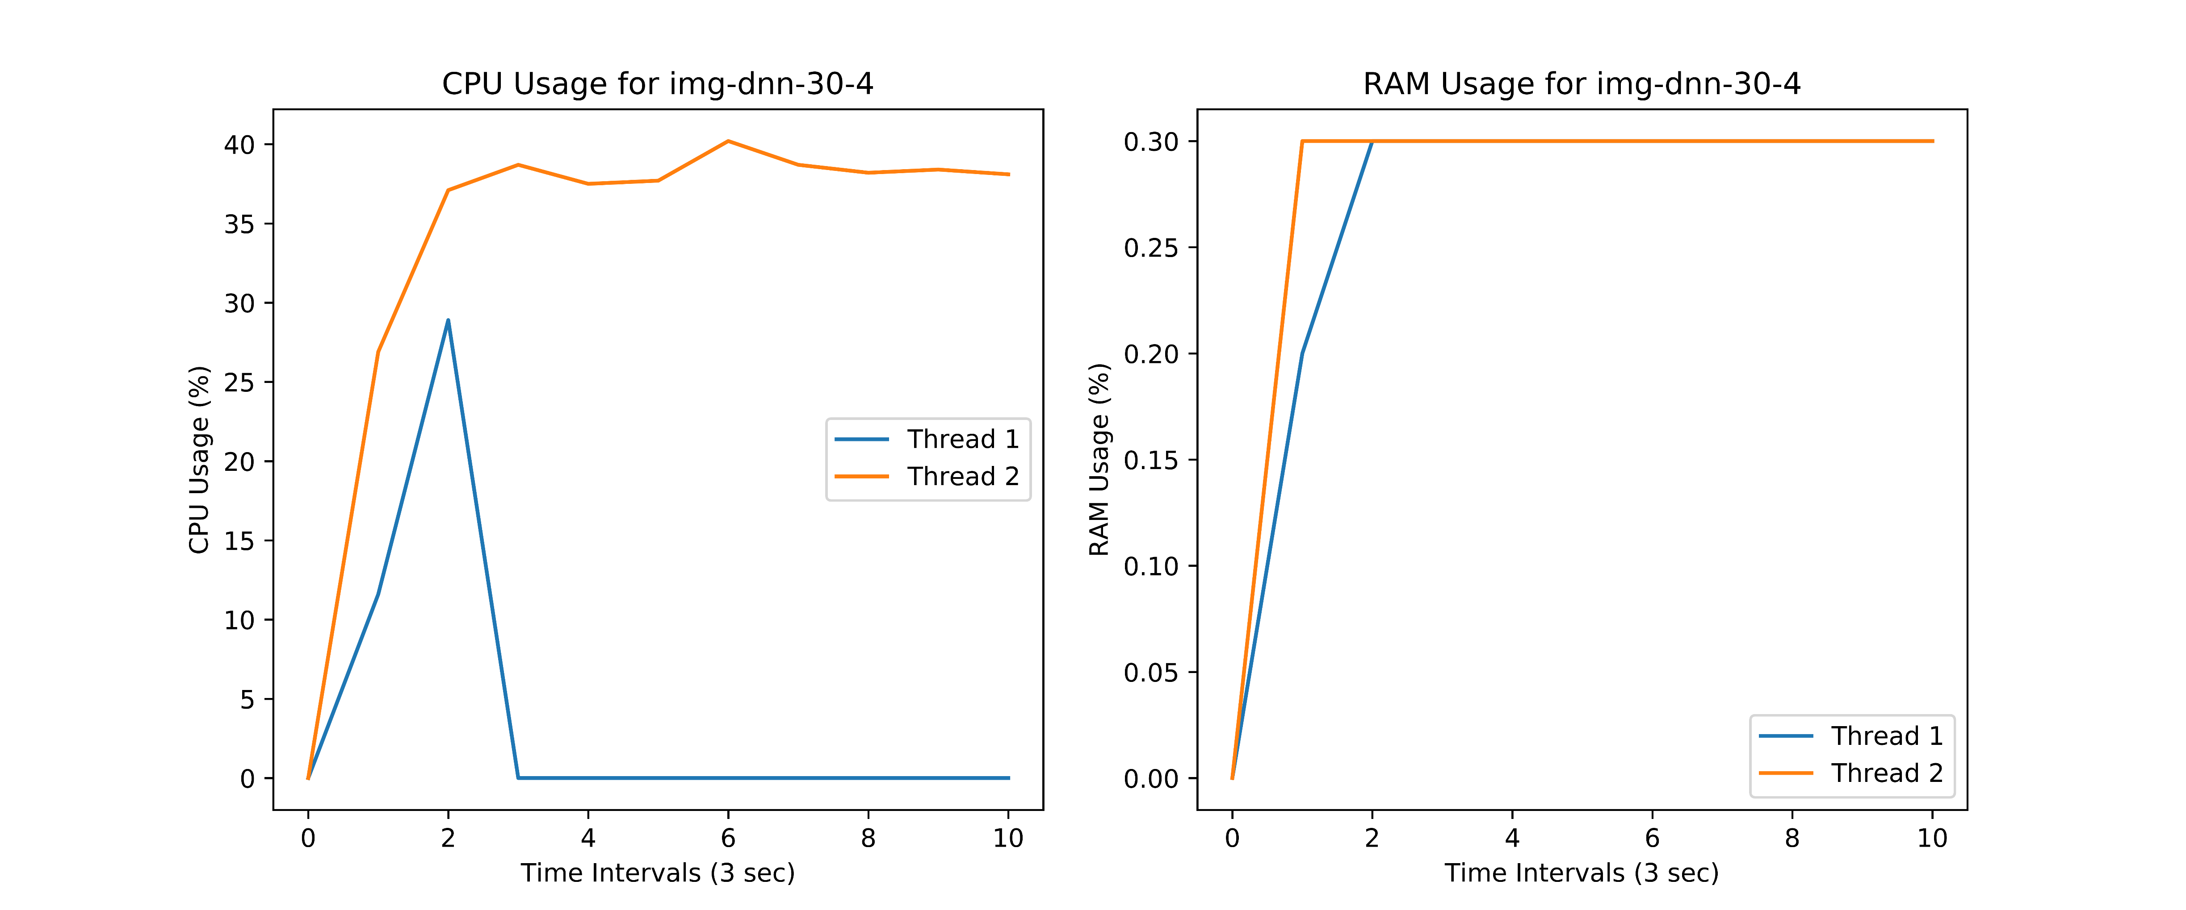
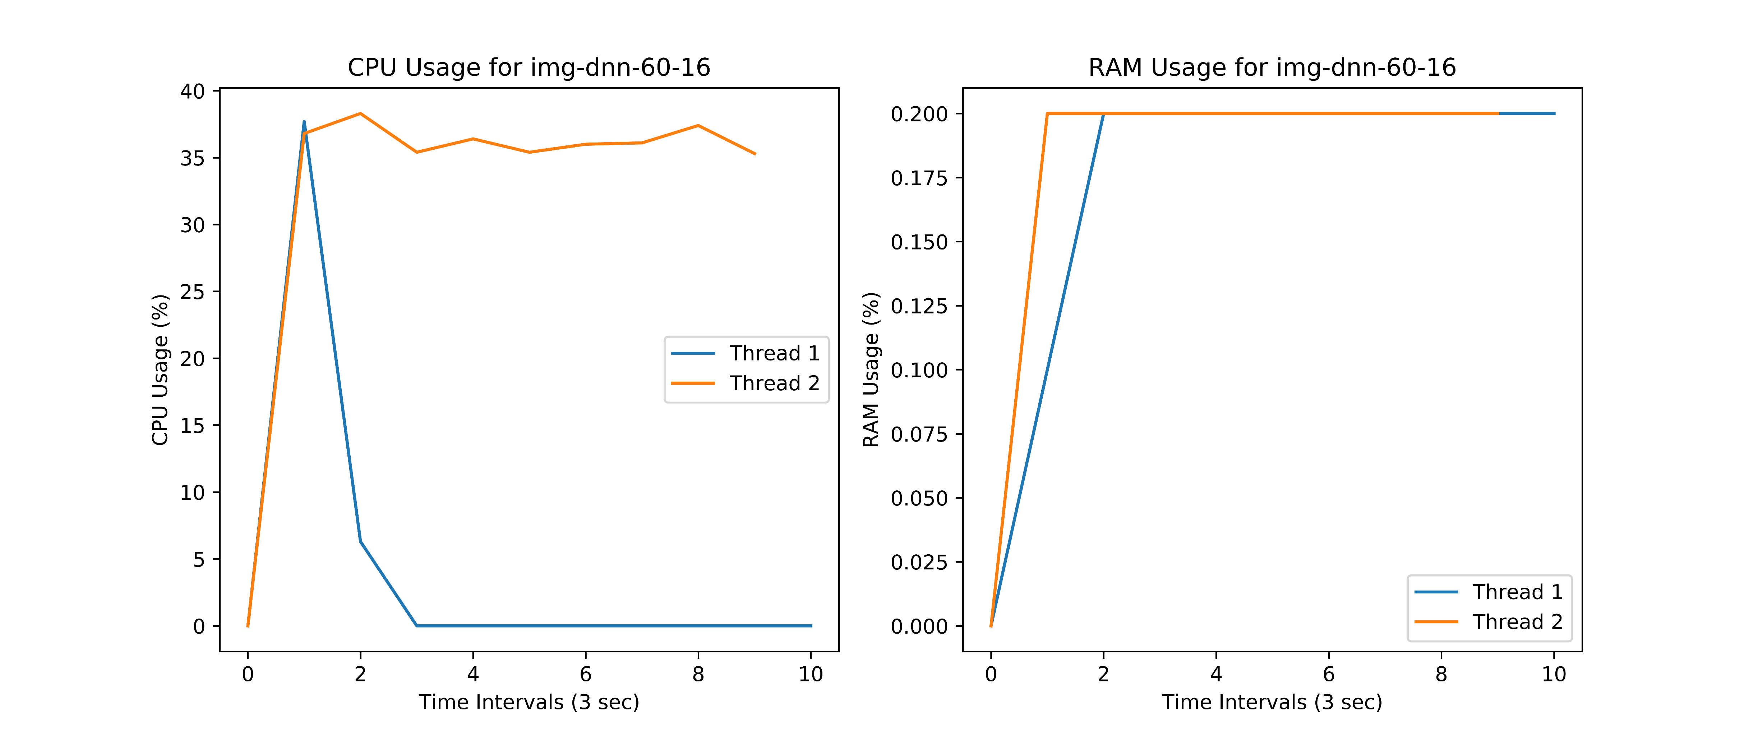

Slide 23
masstree

Slide 24
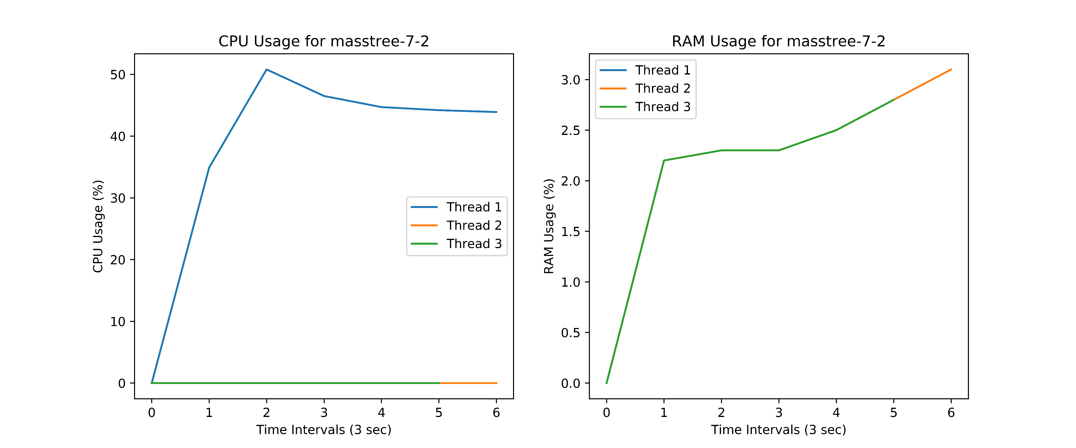
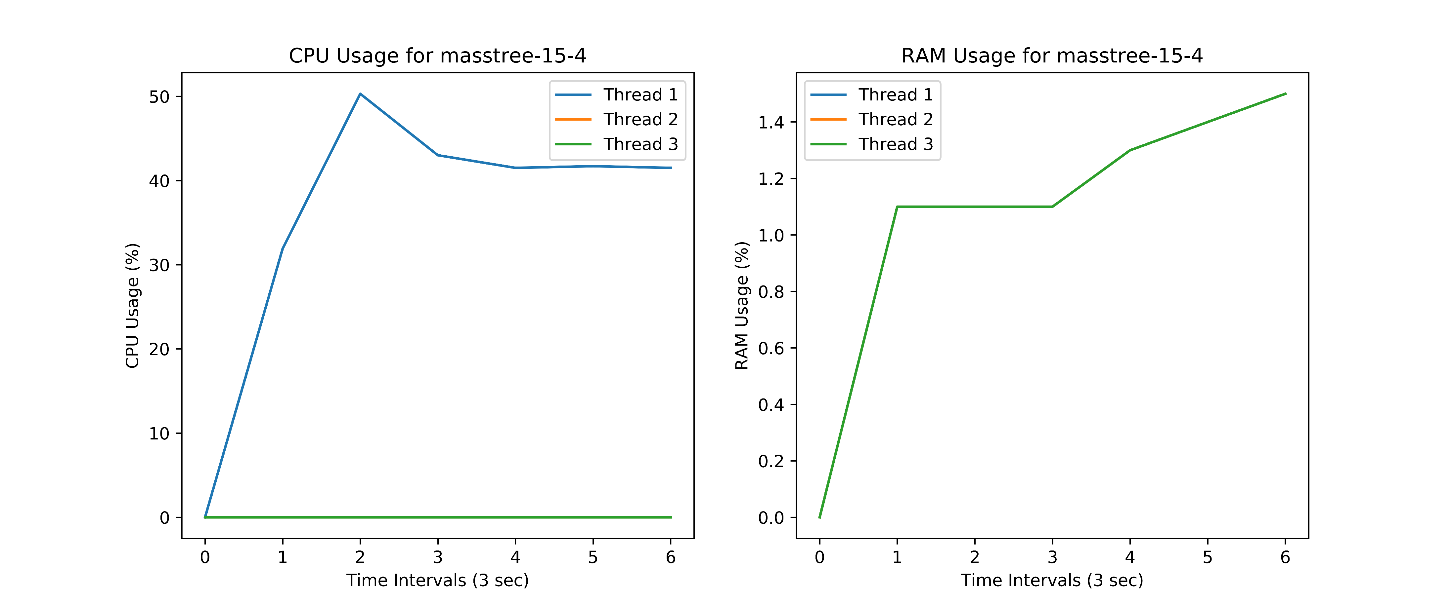

Slide 25
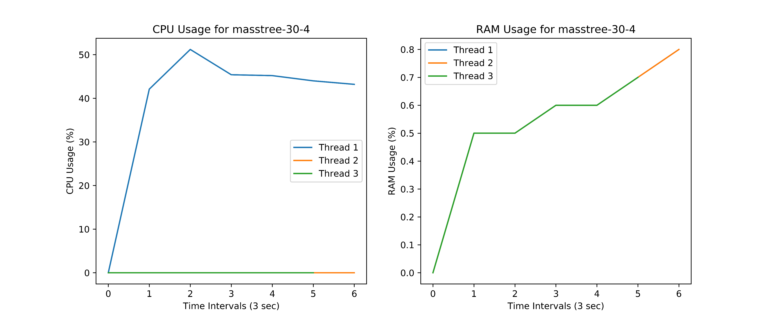
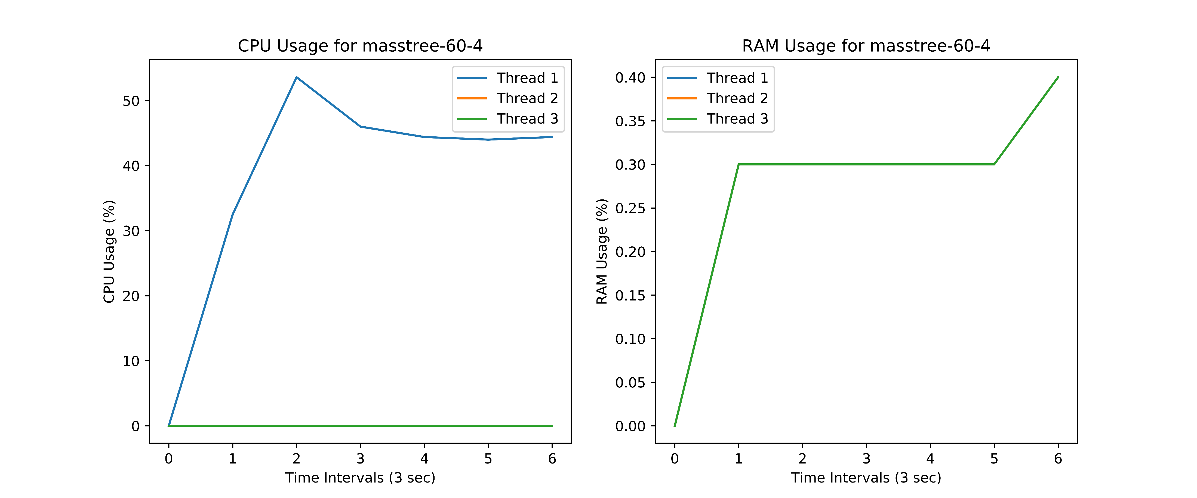

Slide 26
silo

Slide 27
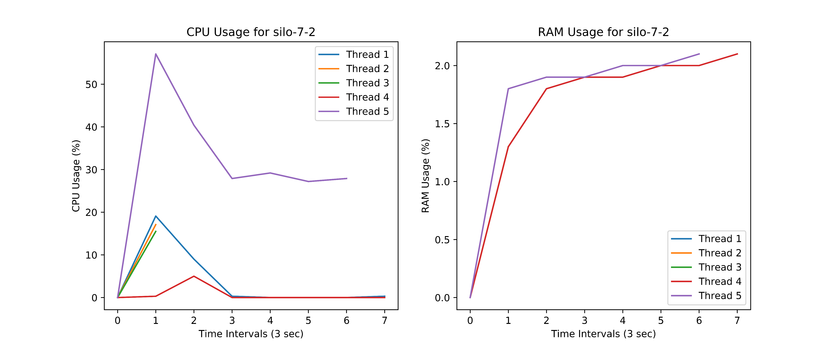
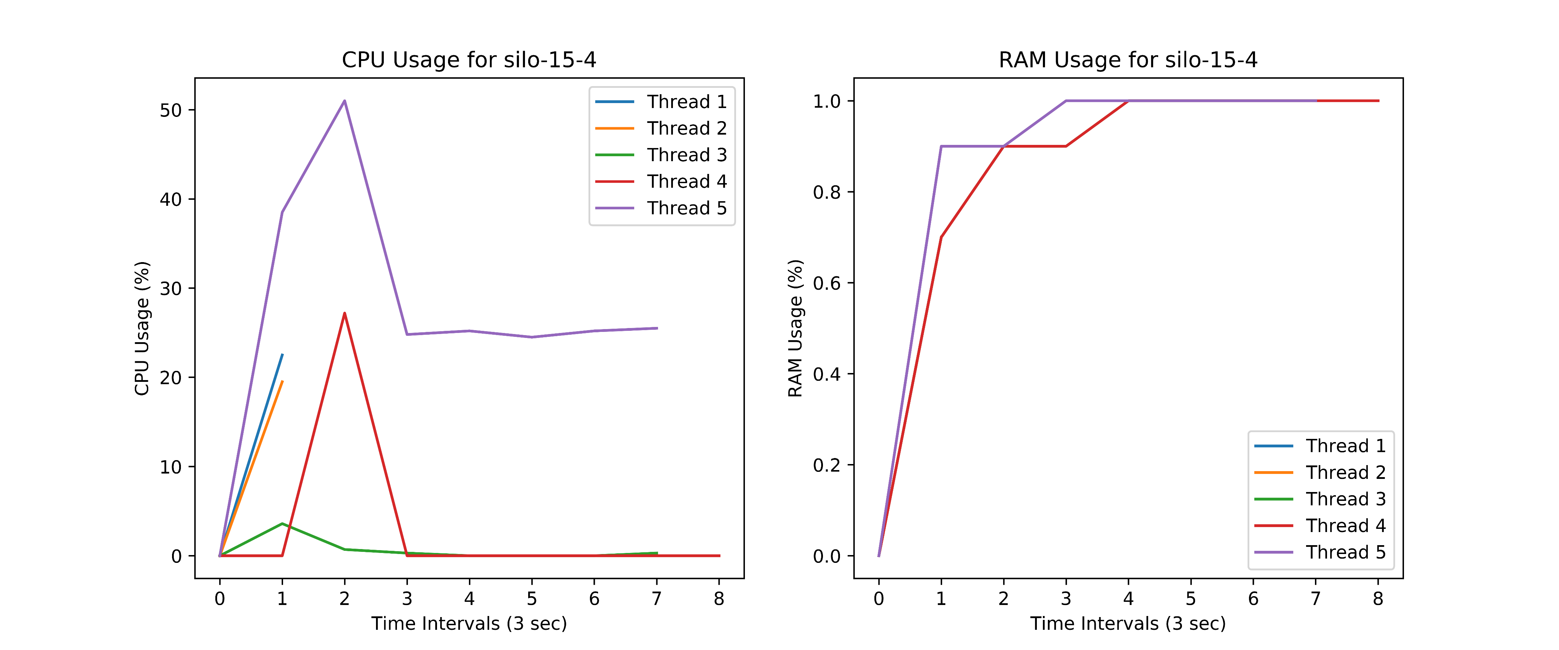

Slide 28
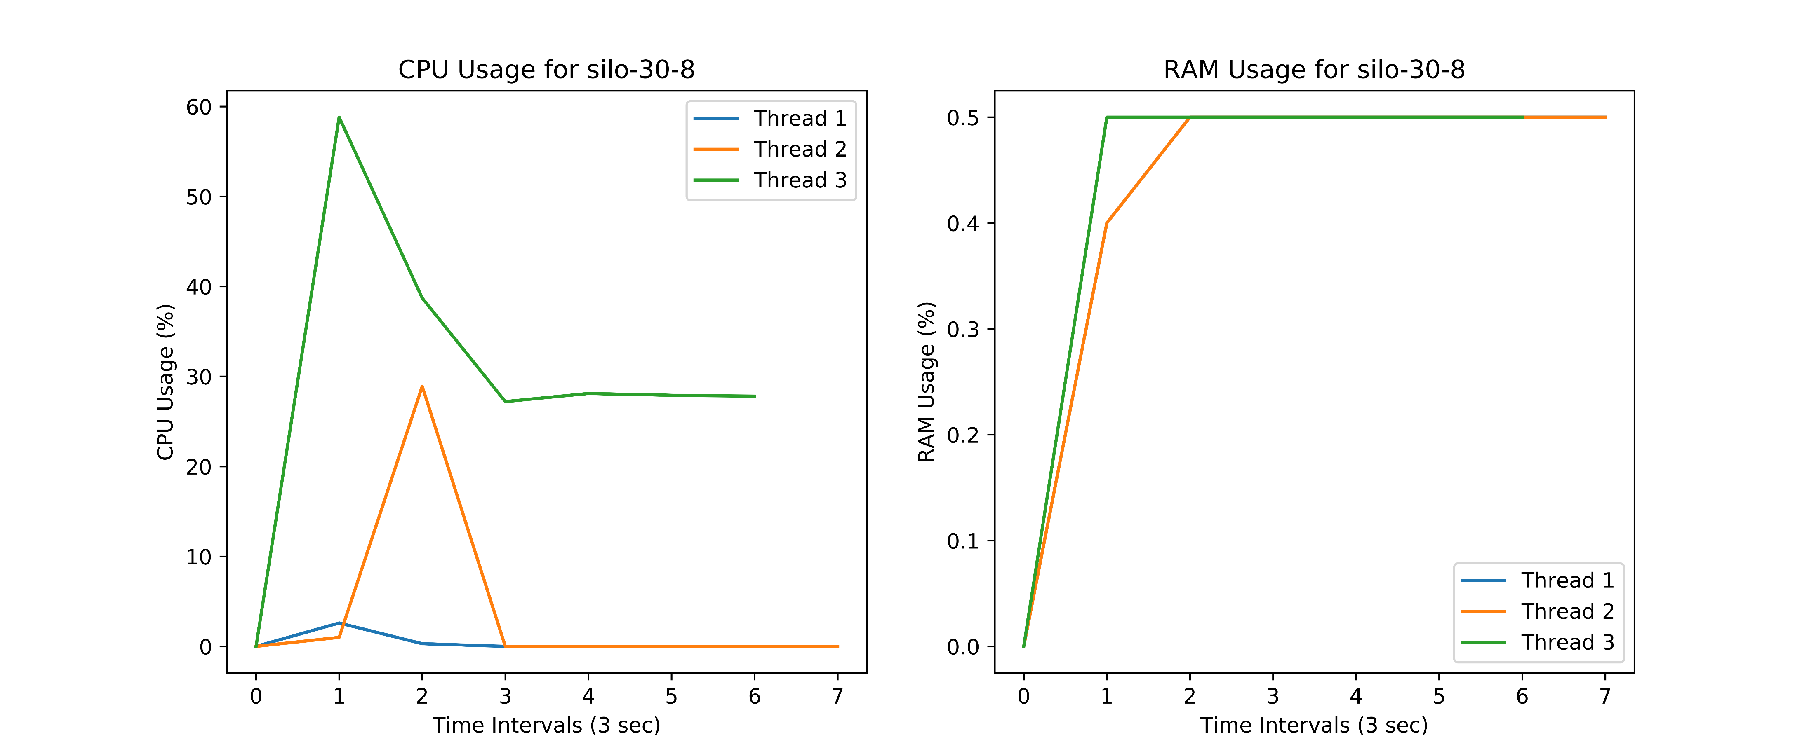
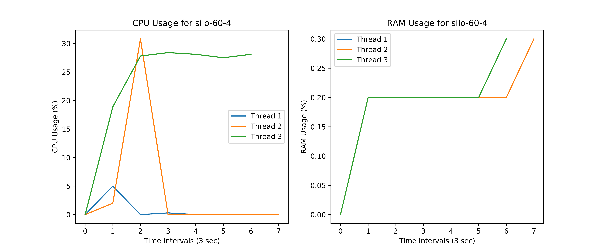

Slide 29
Conclusion - II
Only one of the multiple threads running for various applications took up most of the CPU to run.
For all applications, the memory consumed by each thread was almost a constant.
However, we did find a few threads that did not run throughout the execution time of an application and are looking into the same.
The rest of the plots can be found at https://bit.ly/tbplots

Slide 30
Future Work Plan
We are still trying to build and run the remaining 4 applications
We are planning to figure out a way to explicitly control the number of threads an application uses and monitor the performance and find how the memory consumption changes.
We are also analysing the threads that did not run throughout the execution time of an application

Slide 31

Thank You

